Slide 1
Week 2
Greedy Algorithm

Slide 2
Recall
Divide and conquer
Binary Search
Merge Sort
Powering a number
Multiplying 2 numbers
Matrix Multiplication
Embedding a complete binary tree into a circuit

Slide 3

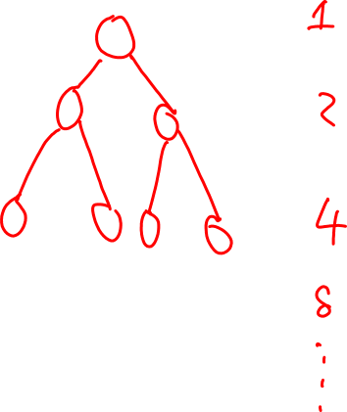
Complete binary tree
Define: A complete binary tree is a binary tree is a binary tree that has $2^{n}$ nodes in level $i$ (provided root is at level 0)

Slide 4
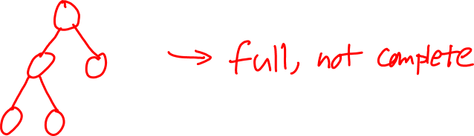
Full binary tree
A full binary tree is called full if every internal node has two children
Fact: A complete binary tree is full, but not vise versa

Slide 5

7) Fibonacci Sequence
$F_{1}=1$
$F_{2}=1$
$F_{n+1}=F_{n}+F_{n−1}, n>2$
1, 1, 2, 3, 5, 8, 13, 21, 34, …

Slide 6

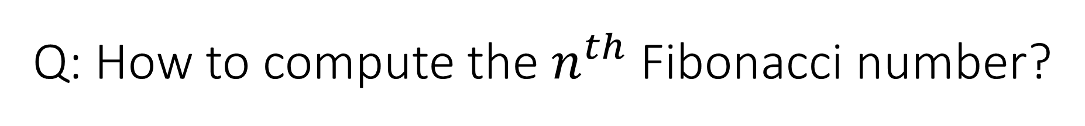
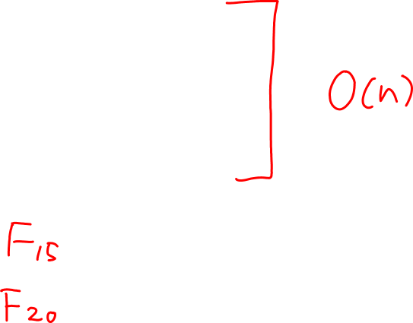
Q: How to compute the $n^{th}$ Fibonacci number?
$f_{1}=1, f_{2}=1$
$\text{for} i=3 :n$
$f_{i}=f_{i−1}+f_{i−2}$
$\text{return} f_{n}$

Slide 7

Bottom-up Approach
$F\left[0\right]=1$
$F\left[1\right]=1$
$\text{for} i=2:n$
$F\left[i\right]=F\left[i−1\right]+F[i]$

Slide 8
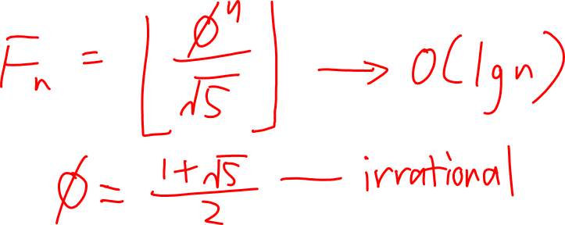
Mathematical Formula

Slide 9

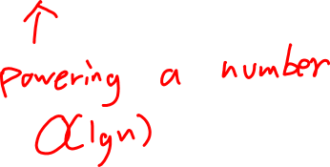
Claim: for every $n≥2$
$\left(\begin{matrix}F_{n+1} & F_{n} \\ F_{n} & F_{n−1}\end{matrix}\right)={\left(\begin{matrix}1 & 1 \\ 1 & 0\end{matrix}\right)}^{n}$
Strassen’s Algorithm: $A_{n×n}×B_{n×n}$

Slide 10
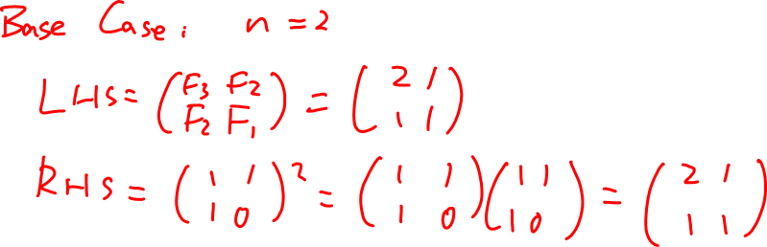
Prove the claim by induction

Slide 11
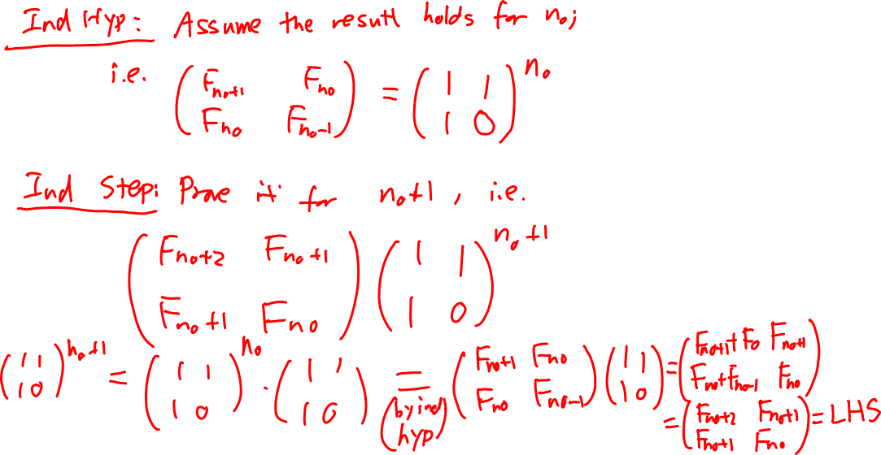
Prove the claim by induction(continued)

Slide 12
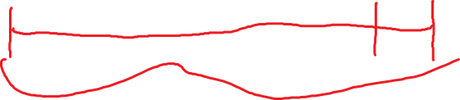
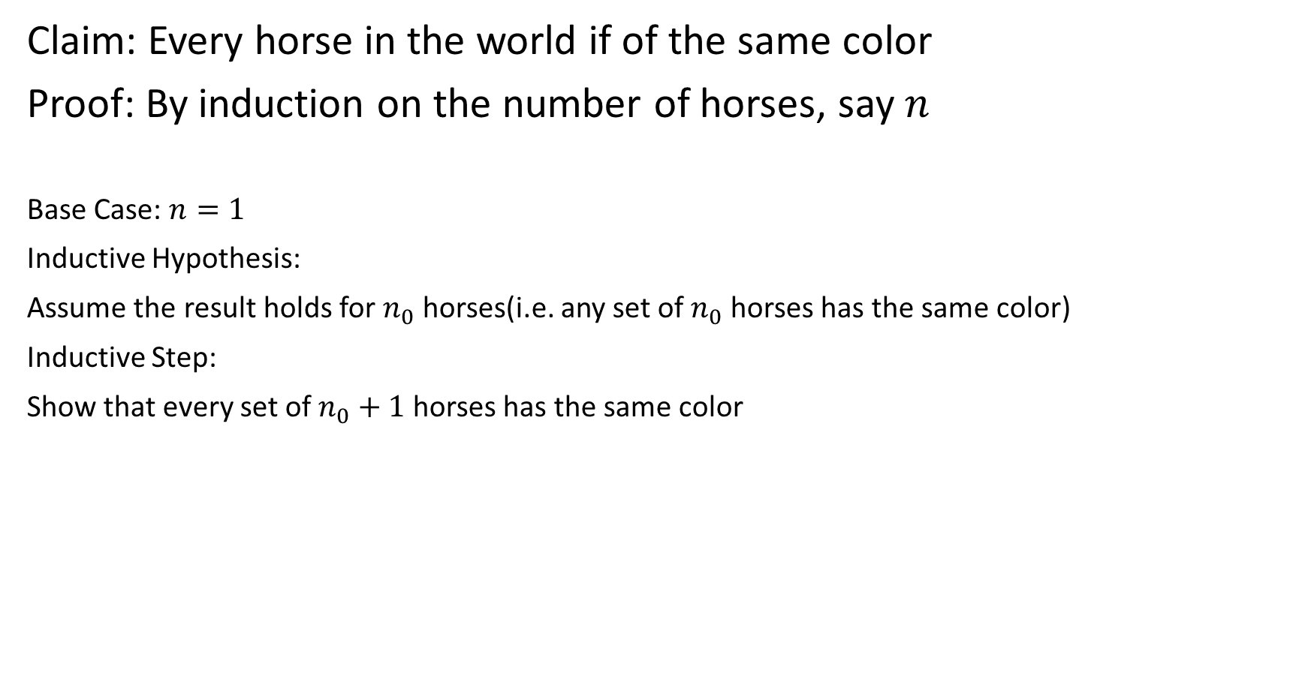
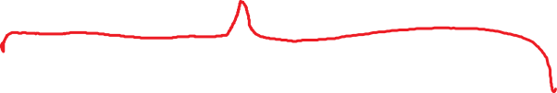
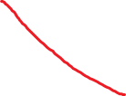
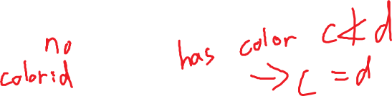


Claim: Every horse in the world if of the same color
Proof: By induction on the number of horses, say $n$
Base Case: $n=1$
Inductive Hypothesis:
Assume the result holds for $n_{0}$ horses(i.e. any set of $n_{0}$ horses has the same color)
Inductive Step:
Show that every set of $n_{0}+1$ horses has the same color

Slide 13

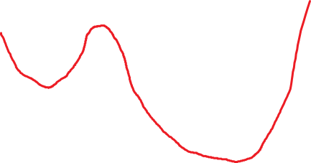


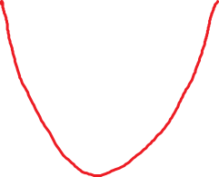
II. Greedy Algorithm

Slide 14








Example 1: Interval Scheduling
Given: A set $R=\{r_{1}, r_{2}, …,r_{n}\}$ of requests, each with a starting time $b_{r_{i}}$ and an ending time $t_{r_{i}}$
Goal: Schedule the maximum number of jobs possible
(There is only one resource)

Slide 15

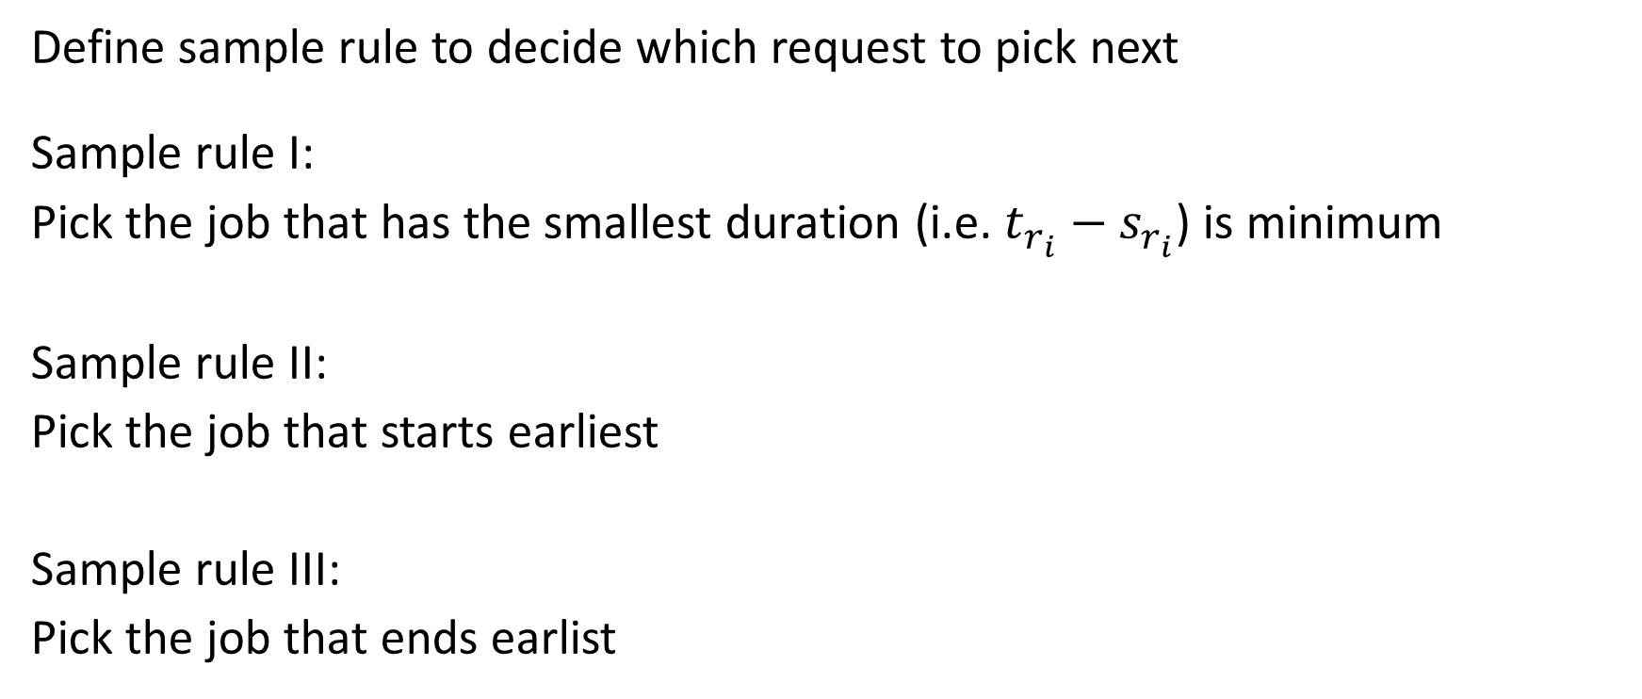


Greedy Approach
Define sample rule to decide which request to pick next
Sample rule I:
Pick the job that has the smallest duration (i.e. $t_{r_{i}}−s_{r_{i}}$) is minimum
Sample rule II:
Pick the job that starts earliest
Sample rule III:
Pick the job that ends earlist

Slide 16
Generic Approaches
“Stay Ahead Approach”
“Exchange Argument Approach”
“Lower Bound” Approach

Slide 17
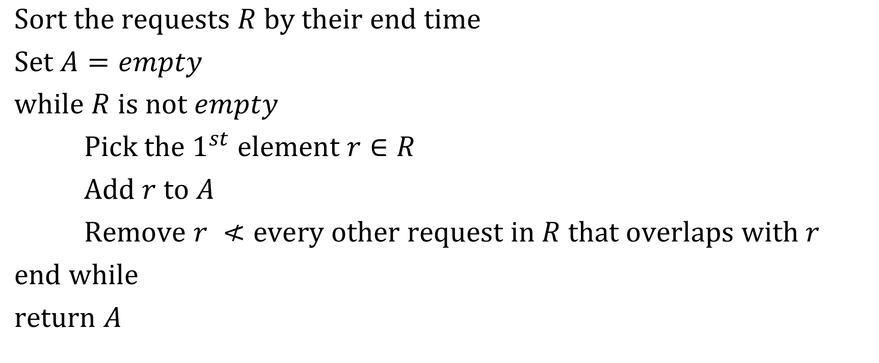
Algorithm
$\text{Sort} \text{the} \text{requests} R \text{by} \text{their} \text{end} \text{time}$
$\text{Set} A=empty$
$\text{w}\text{hile} R \text{is} \text{not} empty$
$\text{Pick} \text{the} 1^{st} \text{element} r∈R$
$\text{Add} r \text{to} A$
$\text{Remove} r ≮\text{every} \text{other} \text{request} \text{in} R \text{that} \text{overlaps} \text{with} r$
$\text{e}\text{nd} \text{while}$
$\text{r}\text{eturn} A$

Slide 18

Proof
Let $θ$ be an optimal solution
Want to show: $\left|A\right|=\left|θ\right|$
$A=\left\{i_{1}, i_{2}, …, i_{k}\right\} \left|A\right|=k$
$θ=\left\{j_{1},j_{2}, …, j_{m}\right\} \left|θ\right|=m$

Slide 19

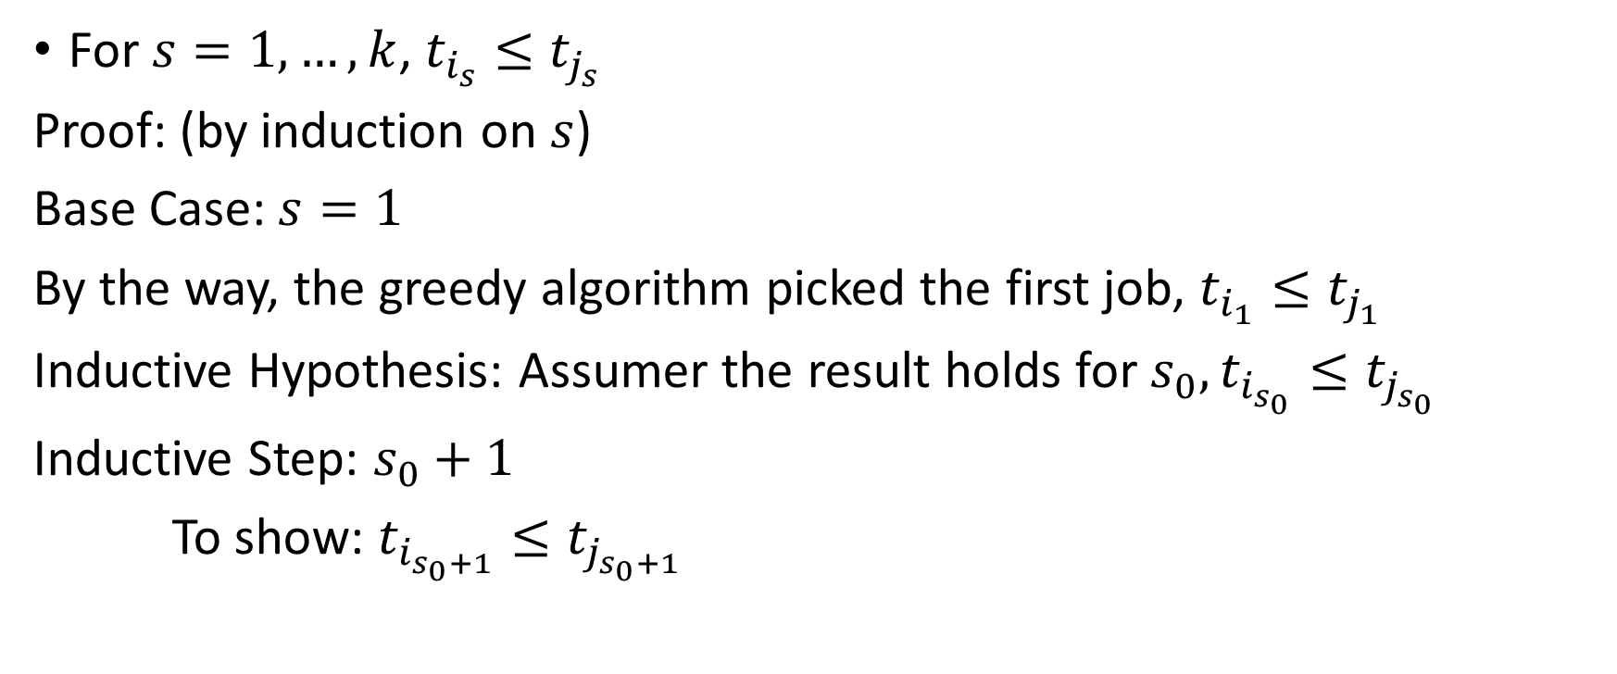




Claim 1
For $s=1,…,k$, $t_{i_{s}}≤t_{j_{s}}$
Proof: (by induction on $s$)
Base Case: $s=1$
By the way, the greedy algorithm picked the first job, $t_{i_{1}}≤t_{j_{1}}$
Inductive Hypothesis: Assumer the result holds for $s_{0}, t_{i_{s_{0}}}≤t_{j_{s_{0}}}$
Inductive Step: $s_{0}+1$
To show: $t_{i_{s_{0}+1}}≤t_{j_{s_{0}+1}}$

Slide 20

Claim 1 (continued)
The next job that the greed algorithm picks is the one that ends soonest among the remaining non-overlapping requests
$j_{s_{0}+1}$ is one such request
is non-overlapping with $i_{s_{0}}$

Slide 21

Claim 2
Greedy Algorithm gives an optimal solution
Proof: $A=\left\{i_{1}, i_{2}, …, i_{k}\right\}$
$\left|A\right|=k$
$θ=\left\{j_{1}, j_{2}, …, j_{k}\right\}$
$\left|θ\right|=m$
WTS: $k=m$

Slide 22
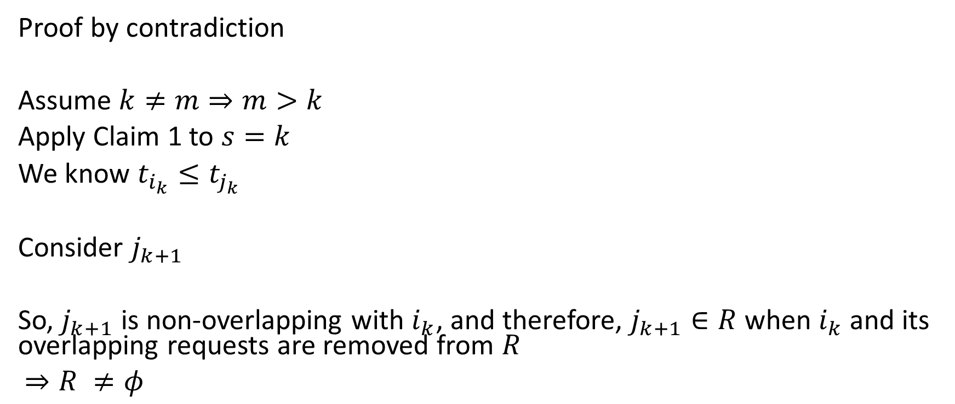

Claim 2 (continued)
Proof by contradiction
Assume $k≠m⇒m>k$
Apply Claim 1 to $s=k$
We know $t_{i_{k}}≤t_{j_{k}}$
Consider $j_{k+1}$
So, $j_{k+1}$ is non-overlapping with $i_{k}$, and therefore, $j_{k+1}∈R$ when $i_{k}$ and its overlapping requests are removed from $R$
$⇒R ≠φ$

Slide 23
Weighted Interval Scheduling
Every job has a priority/weight

Slide 24
Schedule All Intervals
Multiple resources
Goal: to schedule all requests using as few resources as possible (KT)

Slide 25

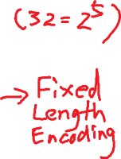
Example 2: Huffman Coding and Data Compression
Text in some alphabet
$S=\left\{a, b, c, d, e\right\}$
$aaebccae$
Goal: Encode the text in minimum number of bits
$S$ has 32 letters
$→$ So use five bits
$a →00000$
$b →00001$
$c →00010$
$⋮$
Text: 8 letters
$\text{Total} \text{number} \text{of} \text{bits}= 8× 5 = 40$

Slide 26
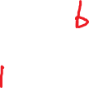


Variable Length Encoding
$a→0$
$b→10$
$c→01$
$n→00001111$

Slide 27
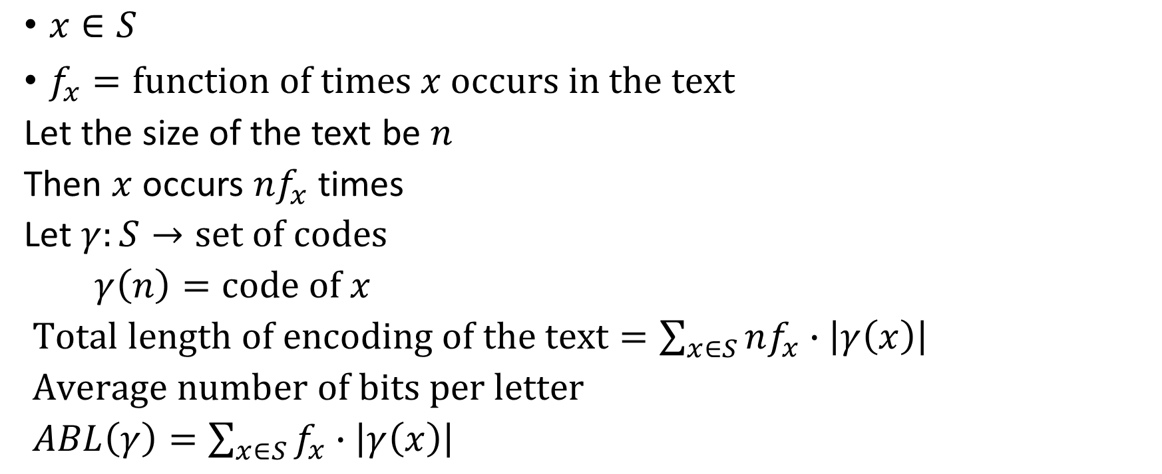
Frequency of Letters in the text
$x∈S$
$f_{x}=\text{function} \text{of} \text{times} x \text{occurs} \text{in} \text{the} \text{text}$
Let the size of the text be $n$
Then $x$ occurs $nf_{x}$ times
Let $γ:S→\text{set} \text{of} \text{codes}$
$γ\left(n\right)=\text{code} \text{of} x$
$\text{Total} \text{length} \text{of} \text{encoding} \text{of} \text{the} \text{text}=\sum_{x∈S}{nf_{x}∙\left|γ\left(x\right)\right|}$
$\text{Average} \text{number} \text{of} \text{bits} \text{per} \text{letter}$
$ABL\left(γ\right)=\sum_{x∈S}{f_{x}∙\left|γ\left(x\right)\right|}$

Slide 28
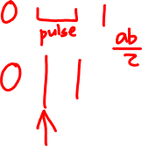

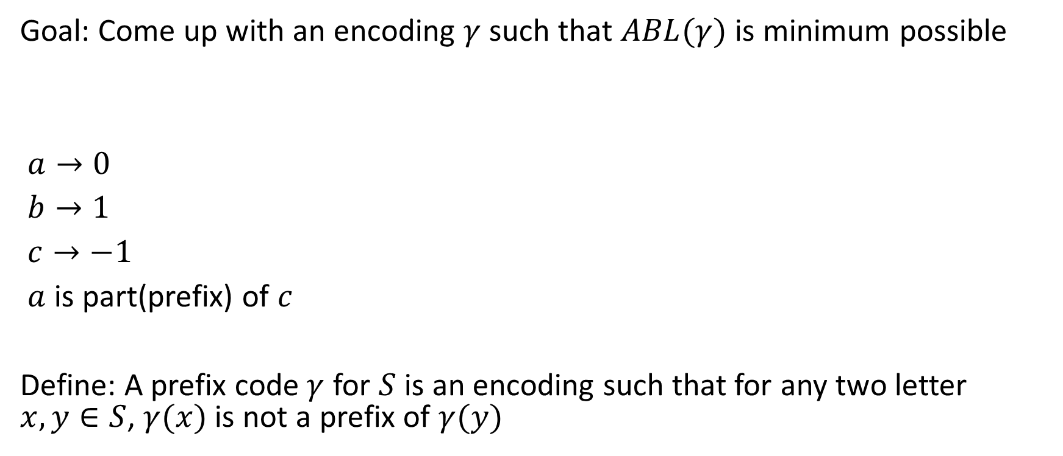
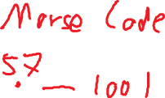

Frequency of Letters in the text (continued)
Goal: Come up with an encoding $γ$ such that $ABL(γ)$ is minimum possible
$a→0$
$b→1$
$c→−1$
$a$ is part(prefix) of $c$
Define: A prefix code $γ$ for $S$ is an encoding such that for any two letter $x, y∈S$, $γ(x)$ is not a prefix of $γ(y)$

Slide 29
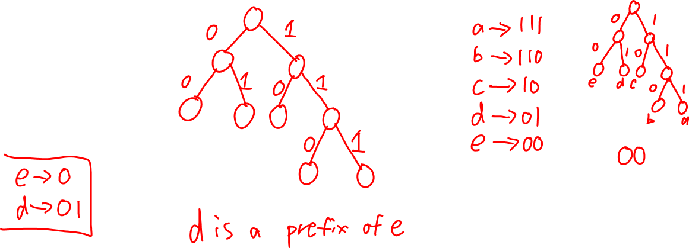
Binary Tree

Slide 30
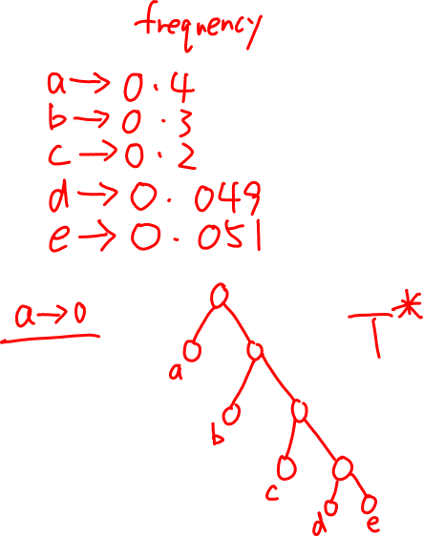
Notes

Slide 31

Let $T^{∗}$ is an optimal tree
Claim: Suppose $u$ of $v$ are two leaves of $T^{∗}$
leaf $u$ is labeled with $x$, and leaf $v$ is labeled with $y$
$Depth\left(u\right)<Depth\left(v\right)$
Then, $f_{x}≥f_{y}$
Algorithm:
$\text{if} S \text{has} 2 \text{letters} x \text{and} y$
$\text{then} x→0, y→1$
$\text{else}$
$\text{Let} y^{∗} \text{and} z^{∗} \text{be} \text{two} \text{lowest} \text{frequency} \text{letters}$
$\text{Form} \text{a} \text{new} \text{letter} w \text{and} S^{′}≔S∪\left\{w\right\} \backslash \left\{y^{∗}, z^{∗}\right\} \text{with} f_{w}≔f_{y^{∗}}+f_{z^{∗}}$
$\text{Recursively} \text{construct} \text{a} \text{prefix} \text{code} γ^{′} \text{for} s^{′}\text{with} \text{tree} T^{′}$
$\text{Define} \text{a} \text{prefix} \text{code} \text{for} S \text{as} \text{follows}:$
$\text{Start} \text{with} T^{′}$
$\text{Take} \text{the} \text{leaf} \text{labelled} w$
$\text{Add} 2 \text{children} \text{to} \text{that} \text{node}\text{,}\text{label} \text{them} \text{as} y^{∗} \text{and} z^{∗}$
$\text{End} \text{if}$

Slide 32
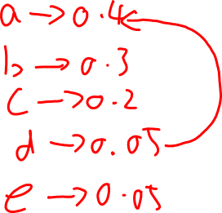
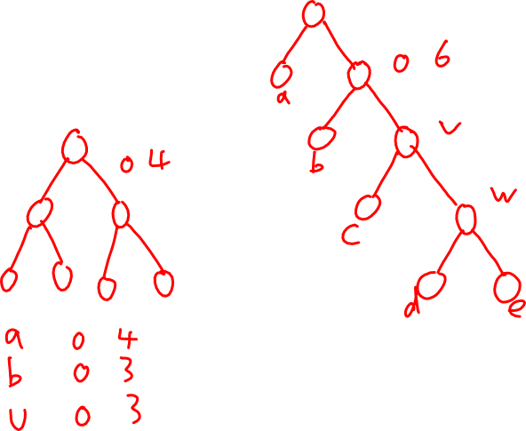
Notes

